Slide 1
SEO FOR OTT
IPCS GLOBAL

Slide 2
Introduction to OTT Platforms

Slide 3
Nowadays, watching a movie or a tv program with relatives is uncommon and everyone has their own preferences. As a result, people like to watch movies or shows on their phones or computers. The platform you are using, whether it is MX Player, Amazon Prime or Netflix is an OTT platform.
At the end of 2020, there is a total of 62 million subscribers.

Slide 4
What is OTT ?
OTT(Over The Top) refers to any video streaming service delivering content to the users over the internet.
OTT bypasses telecommunications, multichannel television, and broadcast television platforms that traditionally act as a controller or distributor of such content.
OTT is the exact technology that made the streaming revolution possible.
OTT services are typically accessed via websites on personal computers, as well as apps on mobile phones(smartphones, tablets), digital media players(video game consoles) or television with integrated smart TV platforms.
Some OTT services(such as iTunes) require that the video be downloaded first and then played, while other OTT players(such as Netflix, Hulu, Peacock, Disney+, HBO Max, Discovery+, Amazon Prime Video) offer movie downloads that start playing before the download complete.

Slide 5
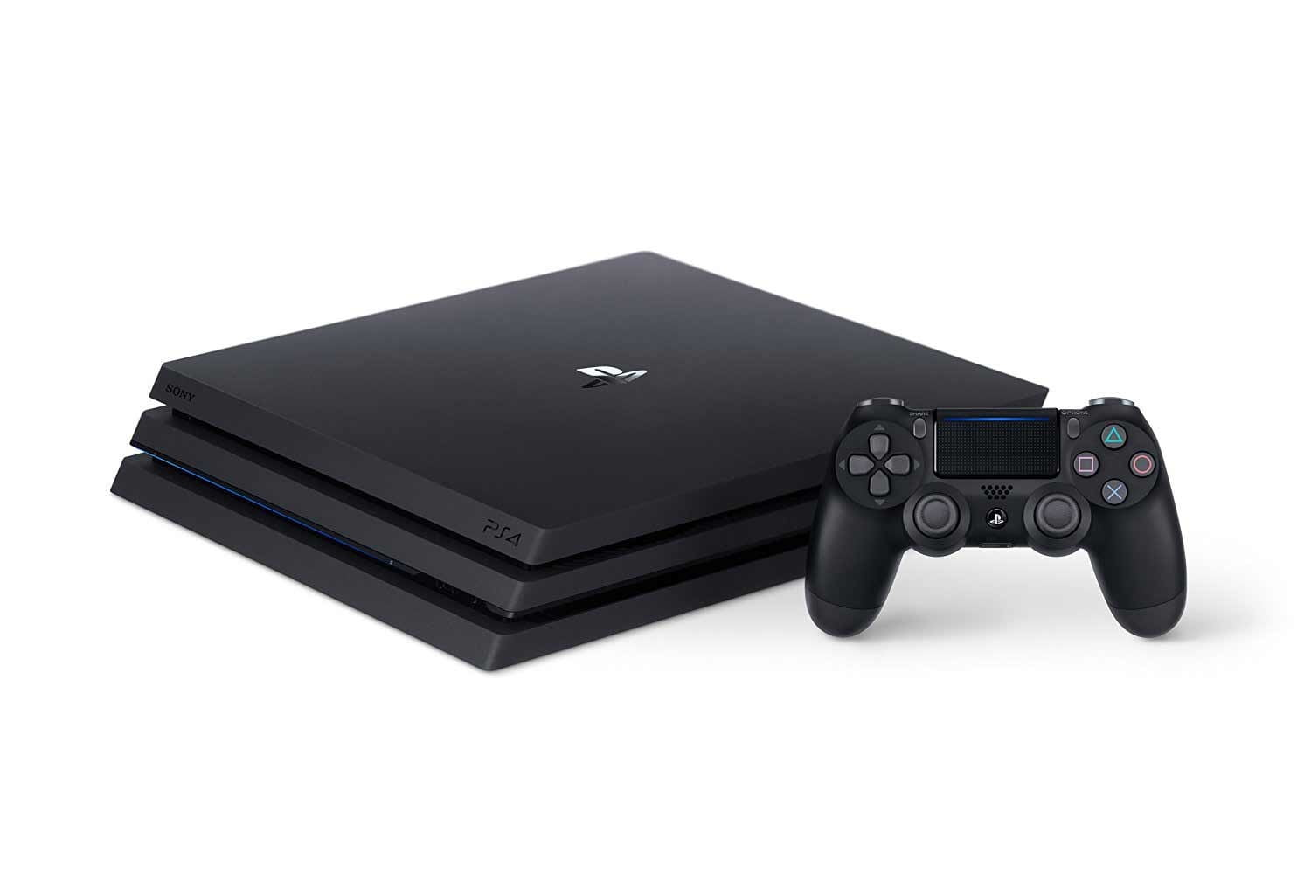
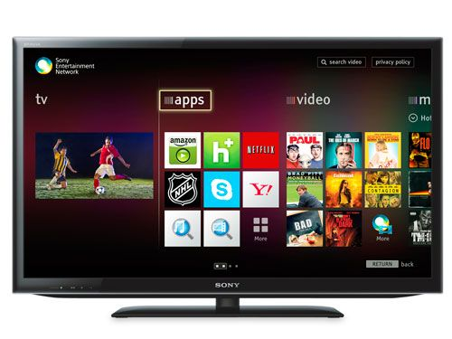
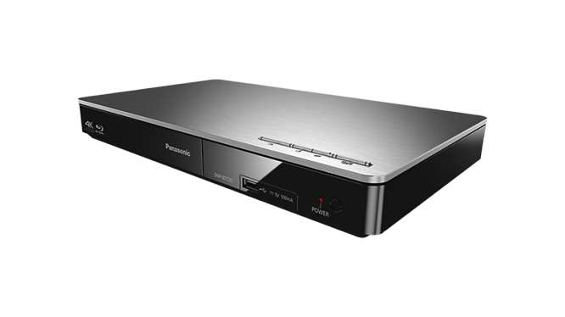

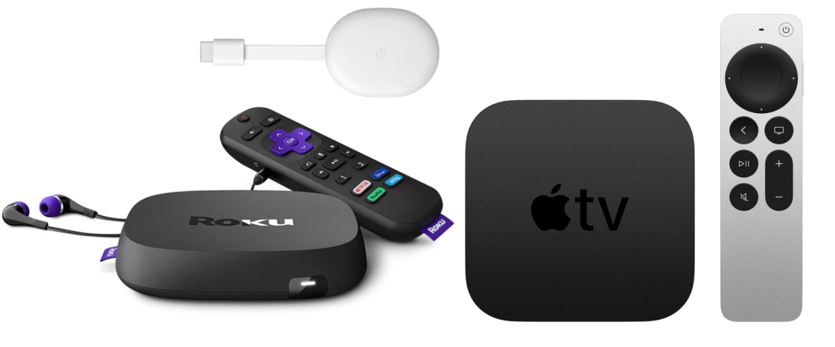
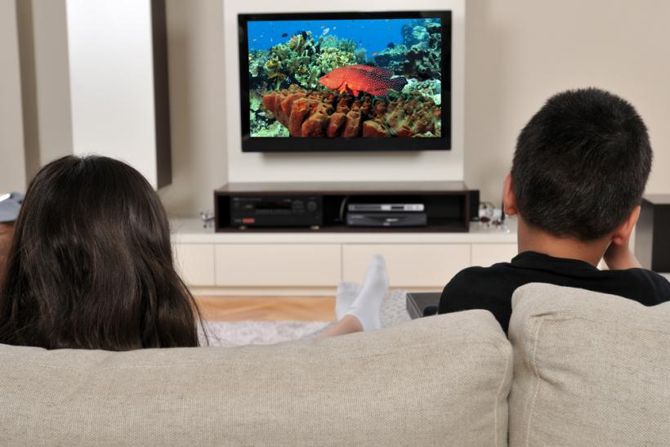

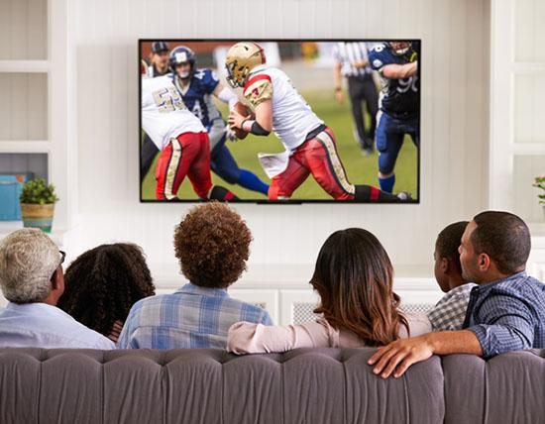
Internet
Streaming media players
Video game consoles
Internet connected TV
Blu-ray disc/DVD players
Smartphones/tablets

Slide 6
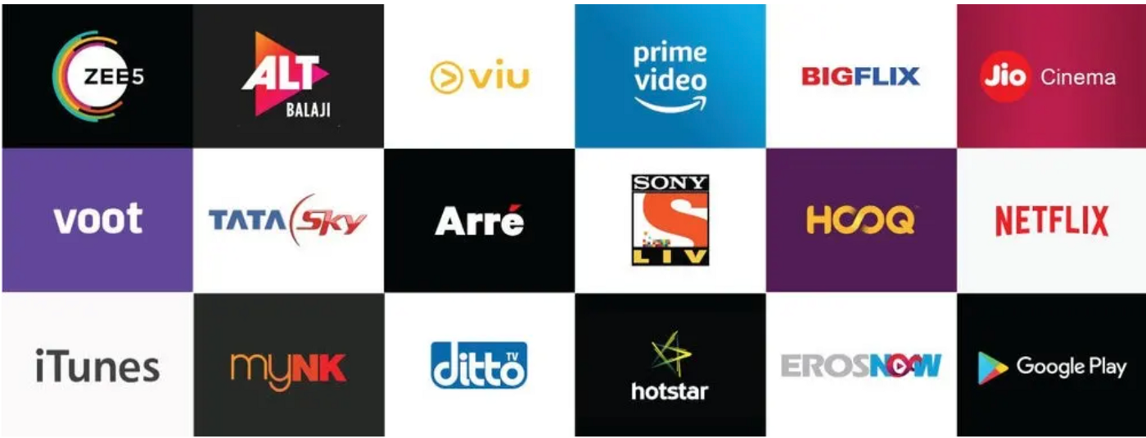

Slide 7
Why OTT platforms growing ?
Different individuals have different preferences
People have different options and views.
For example, if you are living with your parents and grandparents, each one has their own favourites. If there is only one television in your house, how can you go about this?
The answer is simple; OTT platforms. Each member can use different device to watch what they want at the same time.

Slide 8
Convenience
Anytime - The viewer will watch their favourite programs at any time since they are always available on the internet in only a few clicks
Anywhere - Users can watch shows from any location, all they need is a device and an internet connection (in the event of online streaming or shoes could be downloaded).
Everyone - Anyone with any device can use the platform. You will just need to create an account on that website in order to access it.

Slide 9
Quality and fresh content
The OTT app allow you to watch everything. People are also drawn to these platforms since they are tired of conventional TV shows which seem to go on forever.
Streaming before television
Some TV shows and films are streamed on streaming channels even before they are broadcast on television. As a result, for first-time film or web series fans, this is the ideal medium to take their enthusiasm to new heights.

Slide 10
Cost effective
Anyone willing to watch online digital content, can register themselves and pay a monthly or yearly subscription amount which makes it cost-effective.
Open platform for entertainment industry
The biggest advantage of this platform is that it has provided a medium for new talent to get more opportunities as the number of projects are much higher in comparison to television or films

Slide 11
Types of Content

Slide 12
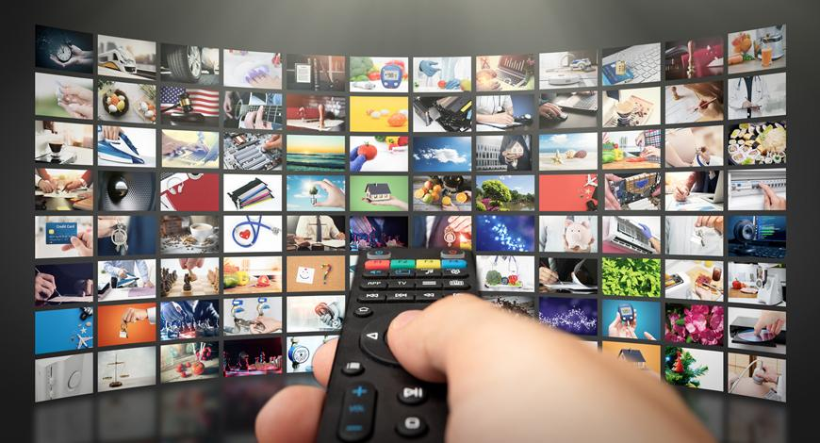
OTT Television
OTT Television remains the most popular content. Usually called as online television, internet television or streaming television.
The signal is received over the internet or through a cell phone network, as opposed to receive the television signal from terrestrial broadcast or satellite.
Access is controlled by the video distributor, through either an app or separate OTT dongle or box, connected to a phone, PC or smart television.

Slide 13
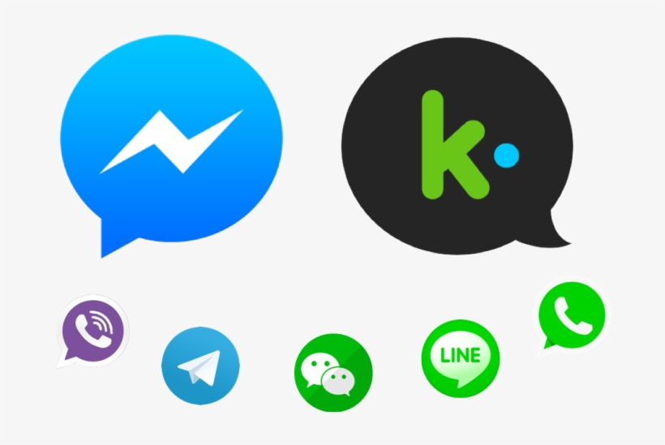
OTT Messaging
OTT messaging is defined as instant messaging service or online chat provided by third parties, as an alternative to text messaging services provided by a mobile network operator.
An example is the Facebook owned mobile application WhatsApp, that serves to replace text messaging on internet connected smartphones.
Other OTT messaging providers include Viber, WeChat, iMessage, Skype, Telegram.

Slide 14
OTT Voice calling
OTT voice calling, usually called as VoIP, use open internet communication protocols and sometimes enhance existing operator controlled services offered by mobile phone operators.
OTT voice calling providers include FaceTime, Skype, Viber, WhatsApp, WeChat and Zoom.

Slide 15
OTT Website Creation

Slide 16
Sign up to https://www.muvi.com to create your video/audio streaming website (14 days free trial).
Muvi store will be created within no time and you can preview your website instantly.
Configure and customize your OTT platform.
Content category: Video/Audio
Content format: single/multi part
Type of content: On-demand/Live-streaming
Select template
Add content to your library
Setup your monetization model
Go live

Slide 17
Introduction to SEO

Slide 18
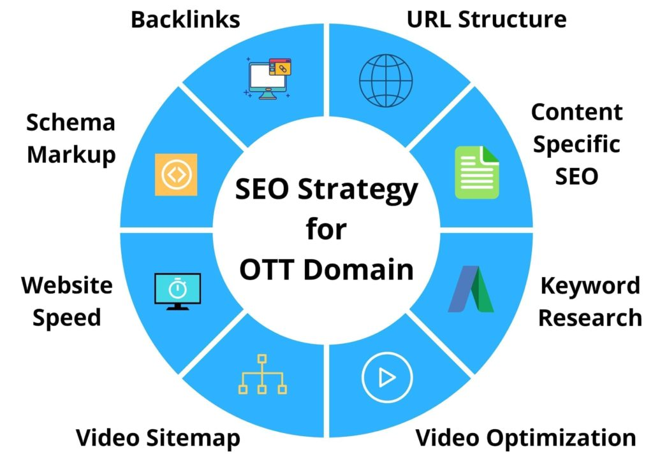
What is SEO
Search engine optimization (SEO) is the practice of increasing the quantity and quality of traffic to your website page through organic search engine results.

Slide 19
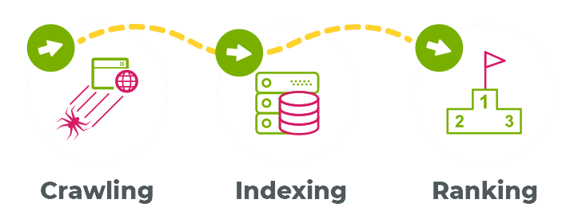
What is Search Engine & How it work
A search engine is a software program that helps people find the information they are looking for online.

Slide 20
Type of SEO
On Page SEO: On page SEO refers to the process of optimizing pages on your site to improve rankings and user experience.
Off Page SEO: Off page SEO refers to actions taken outside of your own website to impact your rankings within search engine results pages(SERP).
Technical SEO: Technical SEO refers to activities that directly impact the indexing and crawling of your site by search engines.

Slide 21
Keywords

Slide 22
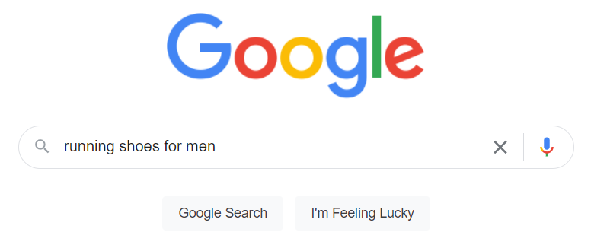
A keyword is a word or phrases that people type into the search engine or search bar to find what they are looking for.
In an SEO strategy, keywords are very important and it is the core of the website, because your website can show up when people type them into the search engine.
Keywords should be developed and selected carefully before launching content online on web and mobile applications.
Keyword
seo for ott platform

Slide 23
Types of Keywords
Short-tail keywords
Short-tail keywords also known as head keywords. Very popular and broad search terms that have high search volume.
These terms usually contain one or two words.
They are very competitive to rank.
Ex: OTT platform

Slide 24
Mid-tail keywords
Mid-tail keywords falls between short-tail, which have high search volume and high competition and long-tail keywords, which have low search volume and less competition and higher conversion rates.
These terms usually contains two to three words and are slightly more descriptive than head keywords.
Ex: SEO for OTT

Slide 25
Long-tail keywords
Long-tail keywords are the longest search terms. They are very targeted to specific topic or audience.These terms have low search volume and low competition, which is easier to rank.
Because they are more specific, and they have higher conversion rates than head and short-tail keywords.
Ex: SEO practices for OTT platform

Slide 26
Keyword Research
Most people have some idea of the keywords to rank for. But it is impossible to know everything people people search for. That’s why we do some research to find more keyword ideas.
There are many ways to do a keyword research (such as LSI, competitor keywords), but the easiest method is to use a keyword research tool.
Choose the best keywords based on search volume and competition.

Slide 27
Tools for Keyword Research
Google Keyword Planner
Keyword Explorer
Ubersuggest
Keywordtool.io
Wordstream
Keyword Tool Dominator

Slide 28
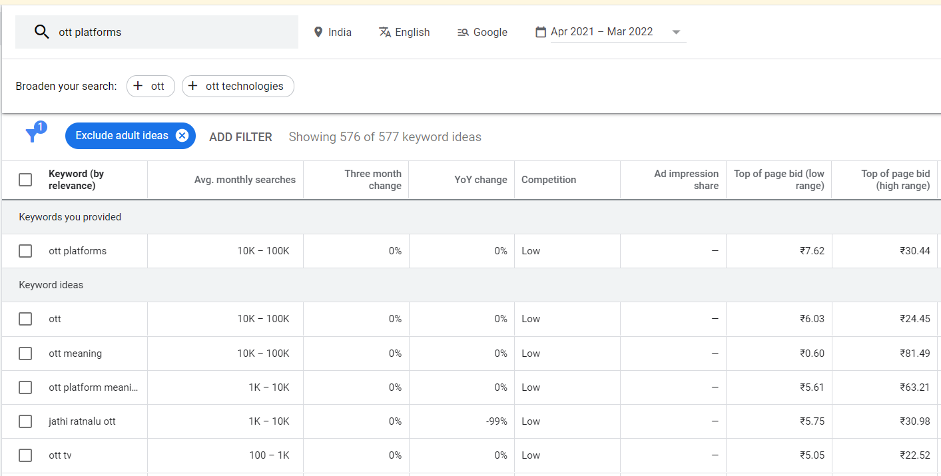

Slide 29
Video Optimization

Slide 30
Optimizing metadata
URL
Having a well structure URL is important for SEO and user experience. It is important that the website crawlers understand what your website is all about. You must use a phrase that best describe your business in the URL. Never forget to add keywords. Use hyphens instead of underscores, as hyphens are treated as spaces between two spaces.
EX:
“https://www.muvi.com/blogs/5_best_seo_practices_for_ott_platforms.html” : non-optimized URL
“https://www.muvi.com/blogs/5-best-seo-practices-for-ott-platforms.html” : optimized URL

Slide 31
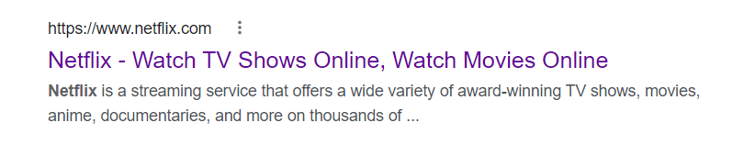
Title Tags
Title tags will be the first thing that are noticed by search engine, hence; the presence of the primary keyword in them is imperative, and you news to make them short and catchy.
Start title with a keyword: Title tag is the important factor in on page SEO.
Try to make the keyword appeared at the beginning of title tag.
Character limit: 55 - 70 characters

Slide 32
Meta Description
Description: A brief description the page
You can make the description a bit longer and organically incorporate multiple keywords in them.
Character limit: 160 characters

Slide 33
Video Tags
Video tags helps to gain relevant traffic from search engines.
Tags where you can incorporate one or two keywords specific to your video content. Make sure to not make these tags spam and it include the OTT provider name, locations, Media broadcasters, and crew.
Thumbnail
Thumbnail will be the first thing that the viewers will see on their search results. Deliver a clear message through thumbnail about your video
These thumbnails can be anything from short descriptions to images that are relevant to the video or the OTT platform, so that the viewer can instantly identify their search results and click on them.

Slide 34
SEO for Static Pages

Slide 35
Add pages
Enter page name
Enter permalink
Content
Save page
Add social media links

Slide 36
Technical SEO

Slide 37
Search Console
Search Console helps you to measure your site’s traffic and performance, fix issues and make your site shine in google search results.
Add property on search console
Submit website URL
Select verification method(HTML tag)
Paste the code in webmaster verification code
Update webpage
Verify search console

Slide 38
Sitemap
A sitemap is a file where you provide information about the pages, videos, and other files on your site, and the relationships between them.
Search engines like google read this file to more intelligently crawl your site. A sitemap tells the crawler which files are important in your site, and also provides valuable information about these files.
In muvi.com it automatically generate sitemap

Slide 39
Robots.txt
A robots.txt file tells search engine crawlers which pages or files the crawlers can or can’t request from your site.
This is mainly used to avoid overloading your site with requests..
It is not a mechanism for keeping a webpage out of google. To keep a web page out of google, you should use noindex tags or directives, or password-protect your page.
Syntax: (edit in notepad) (not permitted during free trial)
User-agent: *
Disallow: /

Slide 40
Schema markup
Schema markup is a code that lets the search engine understand what the words or group of words on the OTT website or platforms’ metadata or descriptions mean. Schema Markup is one of the primary things you should focus on.
Schema markup helps you mark up elements on your web page so that google can understand the data on the page. Once Google understands your page data more clearly, it can be presented more attractively and in new ways in google search.

Slide 41
Google Analytics
Google analytics is a web analytics service offered by google that tracks website performance and collect visitor insights.
Google analytics acquires user data from each website visitor through the use of page tags.
muvi has it’s own built analytics to track revenue, users, user action and content etc.
Google analytics account creation
Account setup
Property setup(GA4)
Paste the code in tracking ID

Slide 42
Website Speed

Slide 43
Optimize Website Speed
Site speed significantly affects organic user traffic.
Compression capabilities: It is imperative that the CSS, JavaScript, and HTML files are of a size smaller than 150 bytes.
Optimize your codes: Make sure that your JavaScript, HTML and CSS codes are optimized and minimal. Remove unnecessary characters, spaces or words from the codes to make the loading speed of your site faster.
Make sure your site doesn’t take more than 4 seconds to load: 75% of users wouldn’t re-visit a site that took longer than 4 seconds to load.

Slide 44
OFF Page SEO

Slide 45
Technic used for Link building from external website improve backlink strength and seo ranking.
Expanding your reach beyond your own OTT domain can bring an influx of viewers for your videos.
Take the help of other OTT hosting sites such as YouTube, Vimeo, DailyMotion, etc. to release short snippets of your content.
Moreover, you can even allow sharing and/or embedding of your video on other websites, which exponentially increases your backlinks.
This improves your website or platform’s authority, and provides high-quality indexing for your videos.

Slide 46
Domain Authority(DA): The Domain authority of a website describes its relevance for a specific subject area or industry. Domain Authority is a search engine ranking score developed by Moz. It is rated out of 100.
Page Rank(PR): It is a value assigned to a web page as a measure of its popularity or importance, used to determine the order in which search engine results are presented. It is rated out of 10.
Dofollow links: Crawlable links by google.
Nofollow links: Nofollow links are links with a rel=”nofollow” HTML tag applied to them. The nofollow tag tells search engines to ignore that link.

Slide 47
Thank You

